Slide 1
Eduland: School on your phone
Auyelbek Yerkebulan

Slide 2
Digital product overview
A tagline for a project:
School on your phone
The main information you need to know about the app:
The theme of my work is a mobile app for a school. I decided to specify my work for schools I graduated from, but with some little changes, it also can be useful for every school.
The target audience of the app is school students of KTL(BIL) of every grade. Even its specified for this kind of school, it can be modified for everyone.
It lives on every mobile platform, also will be developed desktop version.
Functions, features and abilities of the app:
The main function of the application is to facilitate and help schoolchildren and students in promoting learning and socialization in educational institutions.
It's helpful in ordinary offline education as well as in newly introduced online education.
Not only helps with the educational process but also can be used as a social network between students at every school.

Slide 3





Pattern library
As soon as you press any icon it will redirect you to the page you need.
All of icons represents main pages that are necessary for this type of app.
Here they are from left to right:
Messages icon: redirects you to page with chats with teachers, classmates and so on.
Grades icon: redirects you to page of grades of a student.
Schedule icon: redirects you to timetable of a student.
Home icon: redirects you to homepage if you are on other pages.
Homework icon: redirects you to all assignments and homeworks with detailed instructions and deadlines.

Slide 4
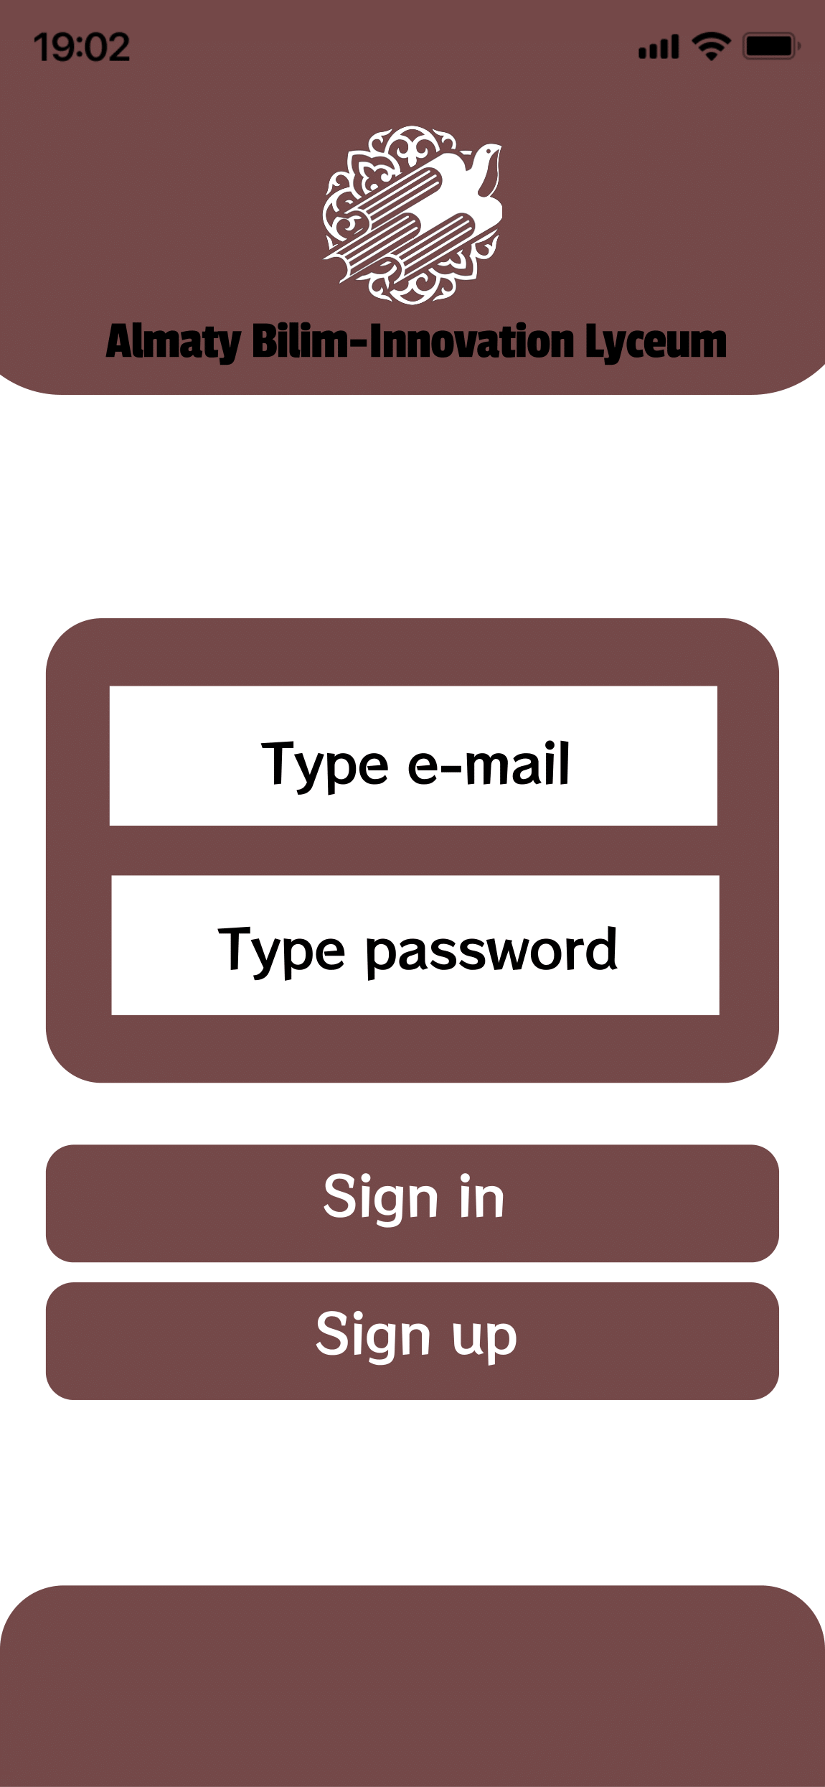
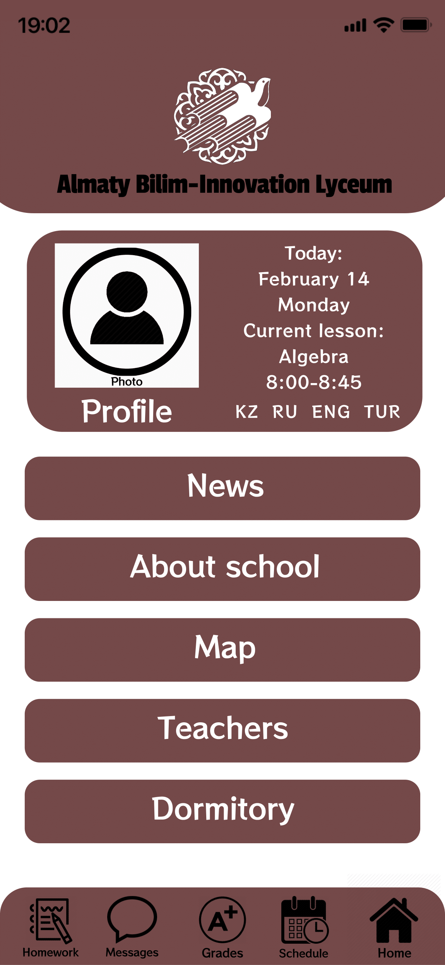
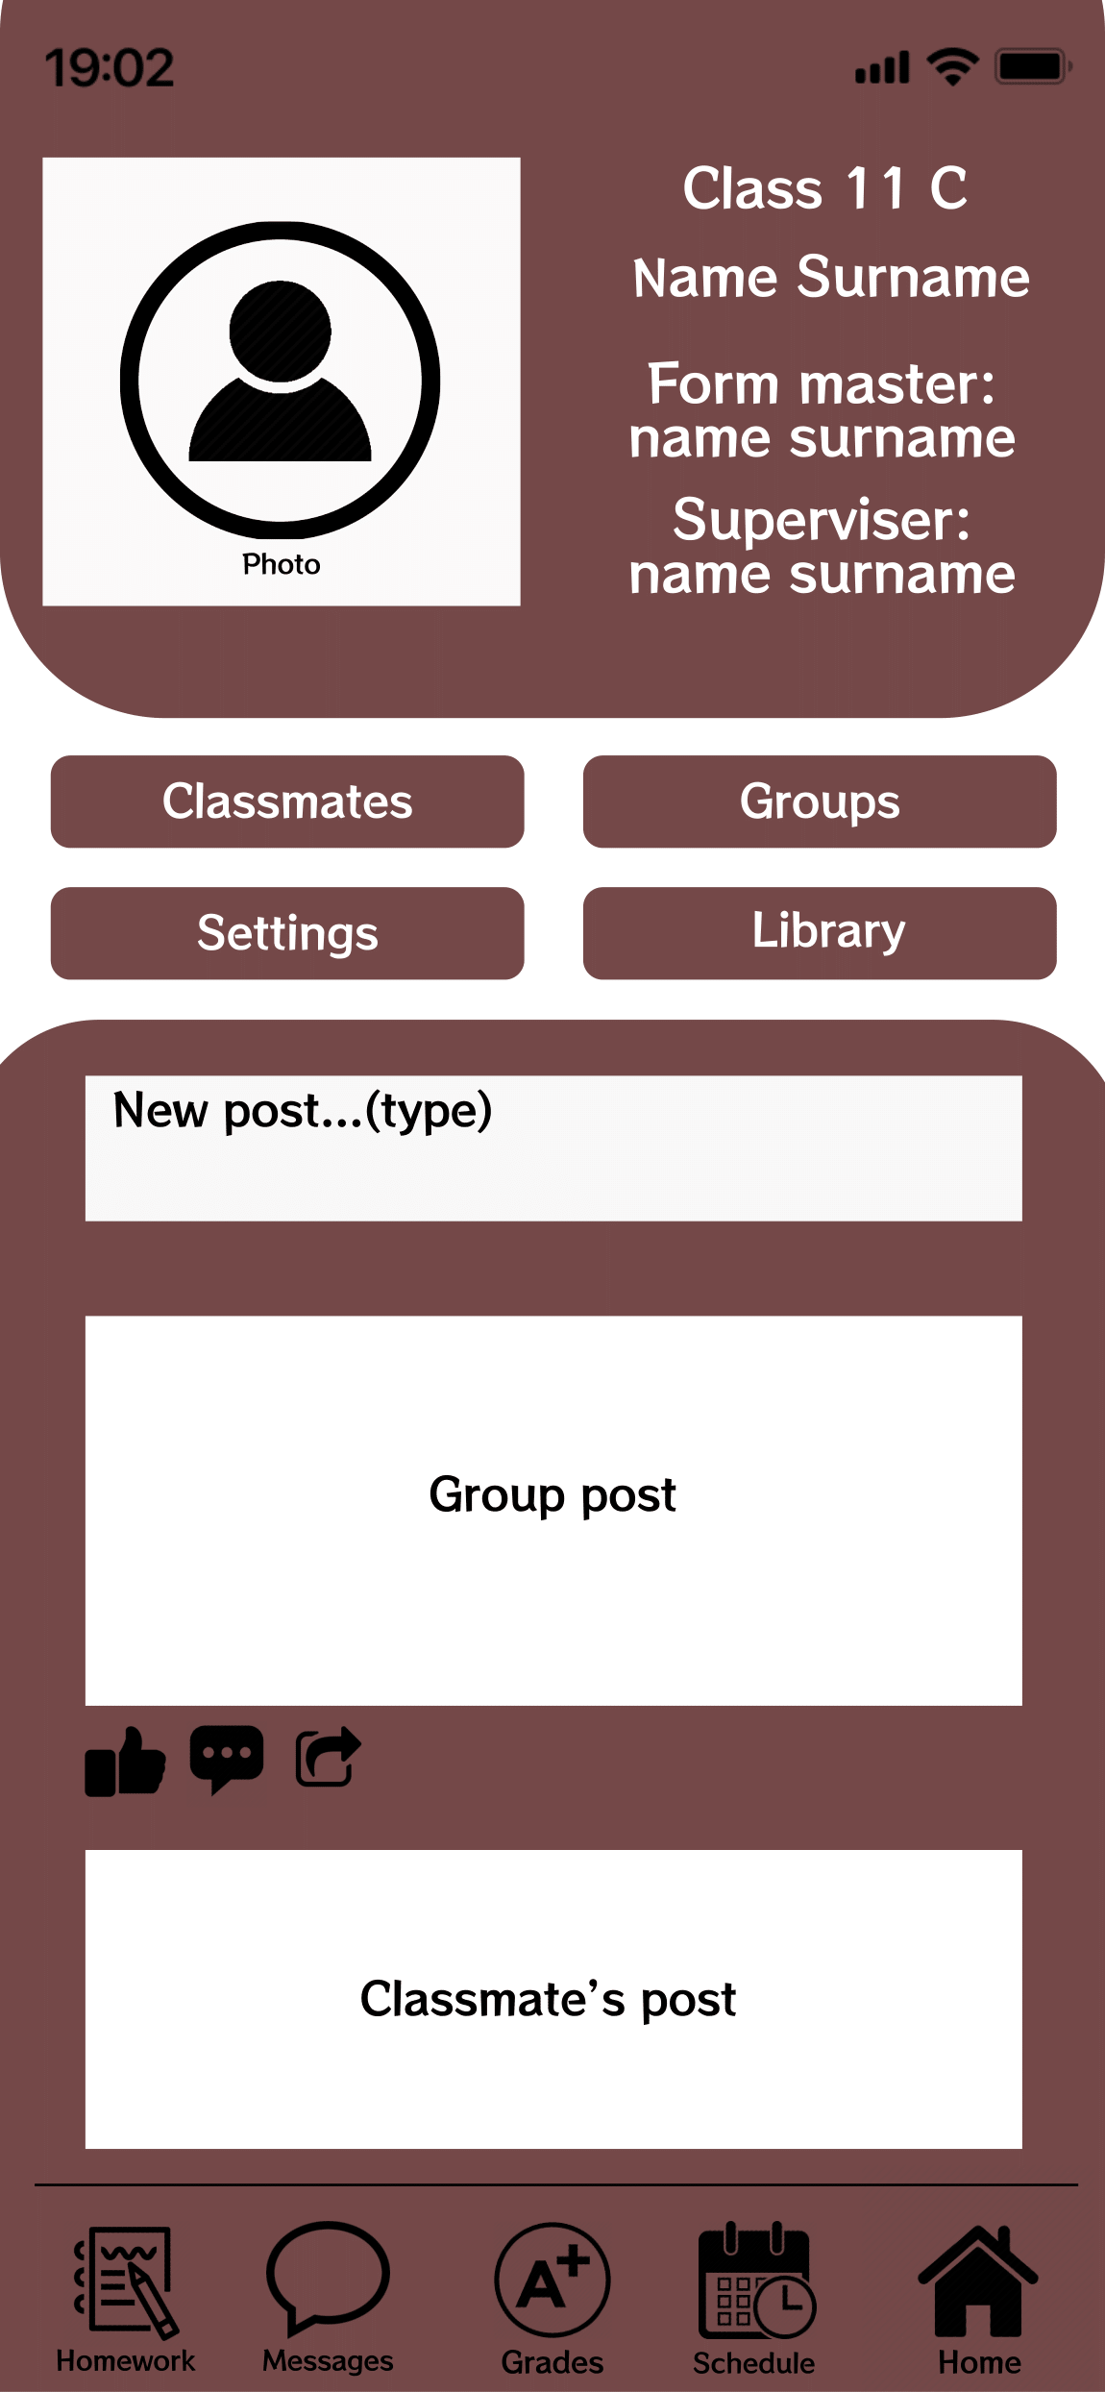
Interface sketches
Here are some sketches of interface of lab.
The first thing new user will see would be login page, then home(main) page and the last one is profile page.
You can look to all sketches that have been done in portfolio by this link: https://sites.google.com/view/portcv

Slide 5
Thank you for attention. Hope you enjoyed!

